Slide 1


IPL Match Winner Prediction
ML Reinforcement
Akilan J
DADS Nov-Batch

Slide 2


Overview
To predict IPL match winners using historical data and machine learning.
Evaluate models using accuracy, precision, recall, and F1-score.
Tune hyperparameters and save the best model for future predictions.

Slide 3
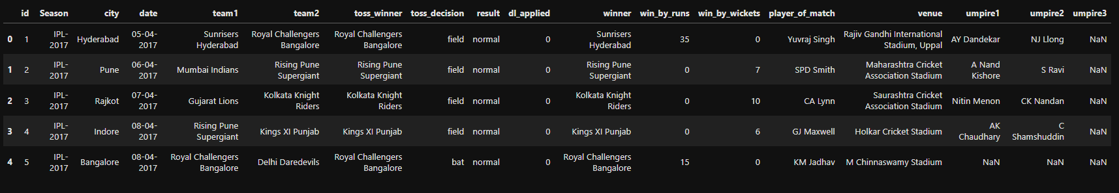
Dataset Explanation
Numerical and Categorical columns with many key factors
Dataset with 756 rows and 18 columns

Slide 4
Data Cleaning
TEAM NAME REPLACMENT
RISING PUNE SUPERGIANT: RISING PUNE SUPERGIANTS
DELHI DAREDEVILS : DELHI CAPITALS
HANDLING MISSING VALUES IN WINNER, CITY
IF MATCH "NO RESULT” (LIKE DUE TO RAIN) - “NO RESULT”
“PLAYER OF THE MATCH” - “NO AWARD”
DROP UN-NECEESARY COLUMN, CORRECTING DATA TYPES
- DATE', 'UMPIRE1', 'UMPIRE2', 'UMPIRE3'
IDENTIFYING AND HANDLING OUTLIERS
ENCODING CATEGORICAL VARIABLES
(LABEL ENCODING, ONE-HOT ENCODING)

Slide 5
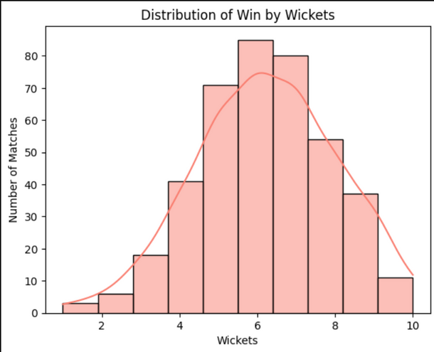
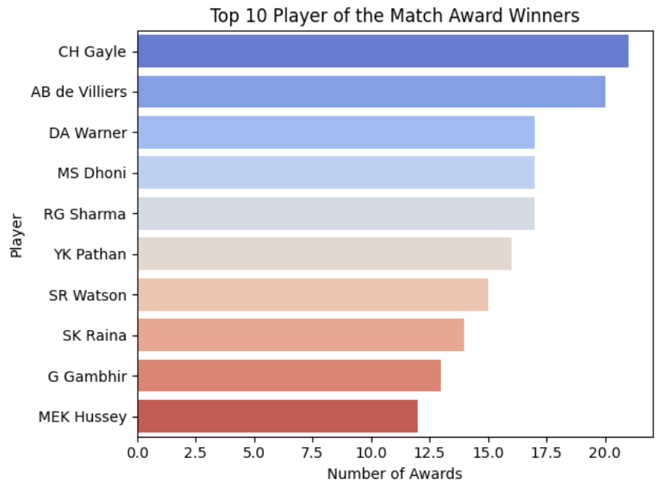
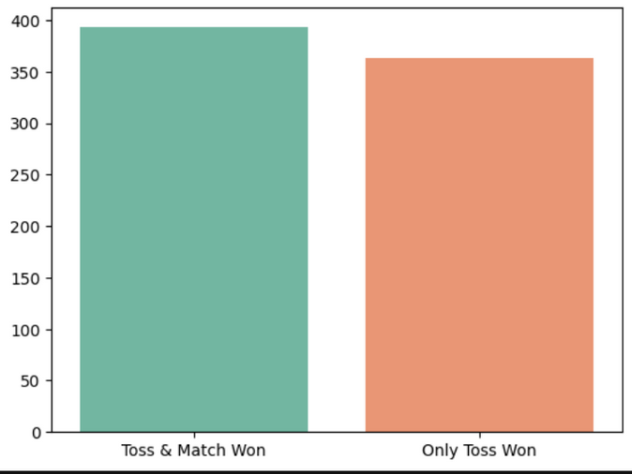
EDA

Slide 6
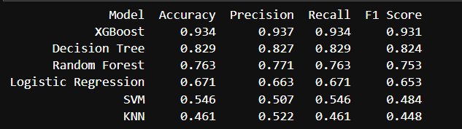
Modeling Process
Logistic Regression
SVM
KNN
Decision Trees
Random Forest
XGBoost

Slide 7
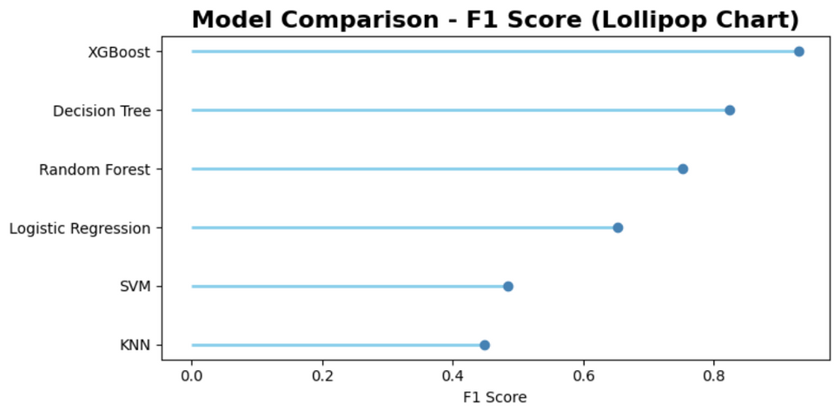
Model Comparison
XGBoost is the recommended model for deployment based on F1 Score.
Tree-based models (Decision Tree, Random Forest) are solid backups with good performance and interpretability.
Avoid SVM and KNN for this dataset unless further tuning or feature engineering is done.

Slide 8


Conclusion
Improve the Model
Add more cricket-related features like player form, venue stats, or head-to-head records.
Use better testing methods to make sure the model works well for all matches.
Fix any imbalance in match outcomes (e.g., if one team wins more often).

Slide 9
Conclusion
Future Steps
User Feedback Loop
Live Predictions
Real-time Inference & Monitoring
Help with Match Strategy

Slide 10
Thank you

